Slide 1

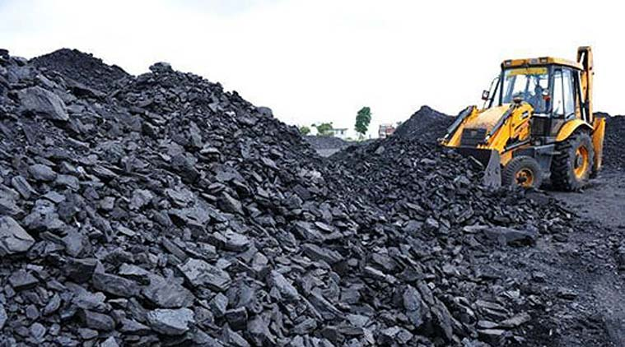

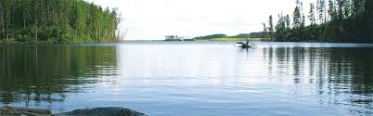
UNIT 2 Natural Resources
2.1 INTRODUCTION
2.2 RENEWABLE AND NON-RENEWABLE RESOURCES.
Natural Resources- associated Problems
FOREST, WATER, MINERAL,FOOD, ENERGY, & LAND RESOURCES
2.3 ROLE OF AN INDIVIDUAL IN CONSERVATION OF NATURAL RESOURCES
2.4 EQUITABLE USE OF RESOURCES -SUSTAINABLE LIFESTYLES

Slide 2
Natural Resources- associated Problems FOREST RESOURCES WATER RESOURCES MINERAL RESOURCES , FOOD RESOURCES , ENERGY RESOURCES LAND RESOURCES

Slide 3
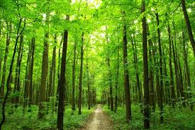
FOREST RESOURCES
Use and overexploitation:
Scientists estimate that India should ideally have 33 percent of its land under forests.
Today we have only about 12 percent.
Thus we need not only to protect existing forests but also to increase our forest cover.
People who live in or near forests know the value
of forest resources first hand because their lives
and livelihoods depend directly on these resources.
How ever the rest of us also derive great benefits from the forests

Slide 4
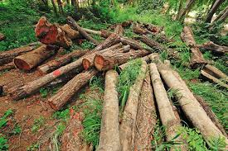
Deforestation:
Deforestation became a major concern in British times when a large amount of timber was extracted for building their ships.
This led the British to develop scientific forestry in India. They however alienated local people by creating Reserved and Protected Forests which curtailed access to the resources.
AFTER INDEPENDENCE TOO OVERUTILIZATION OF FORESTS AND TIMBER EXTRACTION WAS DONE as they thought their right.

Slide 5

Deforestation:
Where civilizations have looked after forests by using forest resources cautiously, they have prospered, where forests were destroyed, the people were gradually impoverished.
Today logging and mining are serious causes of loss of forests in our country and all over the world.
Dams built for hydroelectric power or irrigation have submerged forests and have displaced tribal people whose lives are closely knit to the forest.

Slide 6
FOREST FUNCTIONS
Watershed protection:
• Reduce the rate of surface run-off of water.
• Prevent flash floods and soil erosion.
• Produces prolonged gradual run-off and thus prevent effects of drought.
Atmospheric regulation:
• Absorption of solar heat during evapo-transpiration.
• Maintaining carbon dioxide levels for plant growth.
• Maintaining the local climatic conditions.

Slide 7
FOREST FUNCTIONS
Erosion control:
• Holding soil (by preventing rain from directly washing soil away).
Land bank:
• Maintenance of soil nutrients and structure

Slide 8
FOREST FUNCTIONS
Local use - Consumption of forest produce by local people who collect it for subsistence –
(Consumptive use)
• Food - gathering plants, fishing, hunting from the forest.
(In the past when wildlife was plentiful, people could hunt and kill animals for
food. Now that populations of most wildlife species have diminished, continued
hunting would lead to extinction.)
• Fodder - for cattle.
• Fuel wood and charcoal for cooking, heating.
• Poles - building homes especially in rural and wilderness areas.

Slide 9
FOREST FUNCTIONS
Timber – household articles and construction.
• Fiber - weaving of baskets, ropes, nets, string, etc.
• Sericulture – for silk.
• Apiculture - bees for honey, forest bees also pollinate crops.
• Medicinal plants - traditionally used medicines, investigating them as potential
source for new modern drugs.

Slide 10
FOREST FUNCTIONS
Market use - (Productive use)
• Most of the above products used for consumptive purposes are also sold as a
source of income for supporting the livelihoods of forest dwelling people.
• Minor forest produce - (non-wood products): Fuelwood, fruit, gum, fiber, etc.
which are collected and sold in local markets as a source of income for forest
dwellers.

Slide 11
FOREST FUNCTIONS
Major timber extraction - construction, industrial uses, paper pulp, etc.
Timber extraction is done in India by the Forest Department, but illegal logging continues in many of the forests of India and the world.

Slide 12
CASE STUDY
Joint Forest Management
The need to include local communities in Forest Management has become a growing concern.
Local people will only support greening an area if they can see some economic benefit from conservation.
An informal arrangement between local communities and the Forest Department began in 1972, in Midnapore District of West Bengal.

Slide 13
JFM has now evolved into a formal agreement which identifies and respects the local community’s rights and benefits that they need from forest resources.
Under JFM schemes, Forest Protection Committees from local community members are formed.
They participate in restoring green cover and protect the area from being over exploited.

Slide 14
Next LECTURE :
WATER RESOURCES
FOOD RESOURCES
MINERAL RESOURCES
Thank you

